Slide 1
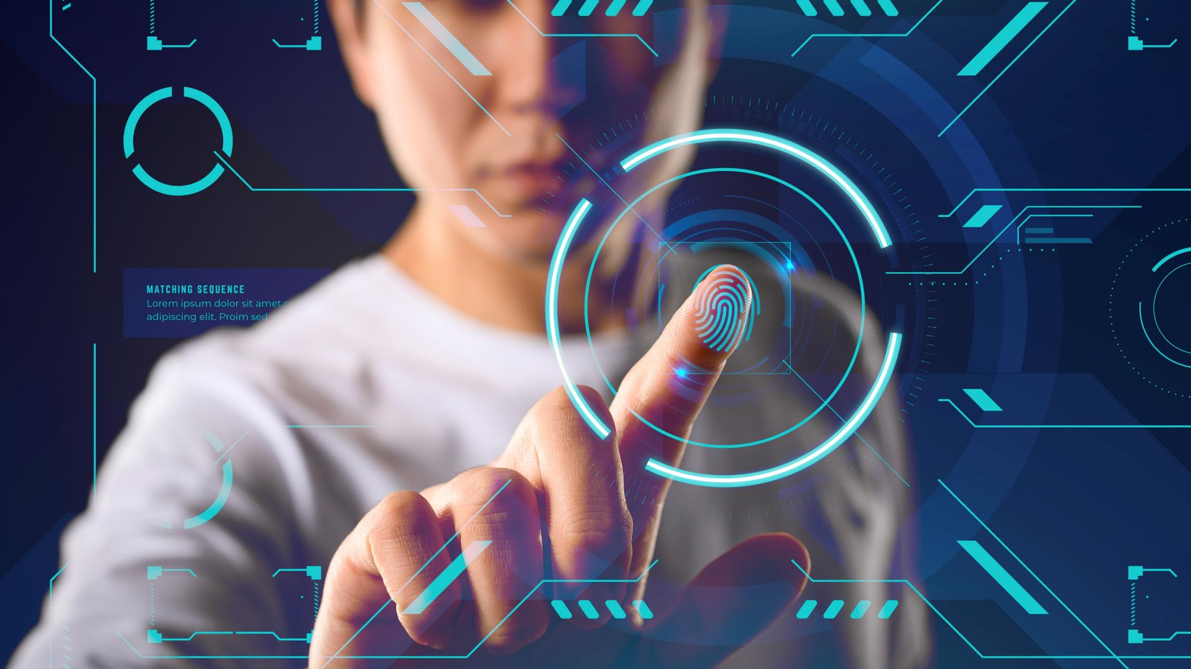
PALM VEIN IDENTIFICATION- BIOMETRIC SECURITY
Guide: Ms. Veena Antony
Asst Professor BCA(CT&ISM)
St. Teresa's College, Ernakulam
ANAIDA SUNIL - SB20BCA005
NIFIYA ALPHO GOMEZ- SB20BCA029
Notes:
https://www.freepik.com/free-photo/futuristic-technology-screen-interface_7136702.htm#page=1&query=cyber&position=0

Slide 2


CONTENTS
ABSTRACT
INTRODUCTION
EXISTING SYSTEM
PROPOSED SYSTEM
SYSTEM ARCHITECTURE
MODULE DESCRIPTION
CONCLUSION

Slide 3
ABSTRACT
As a biometric trait, palm vein pattern-based technology is highly effective for personal identification with high security.
In this we proposed a system that identifies palm vein images of a human by using Deep Learning. As everyone has a unique vein pattern in their palm, which can be used as an identification and security technique. Here we are using VGG-19 model for palm vein identification.

Slide 4
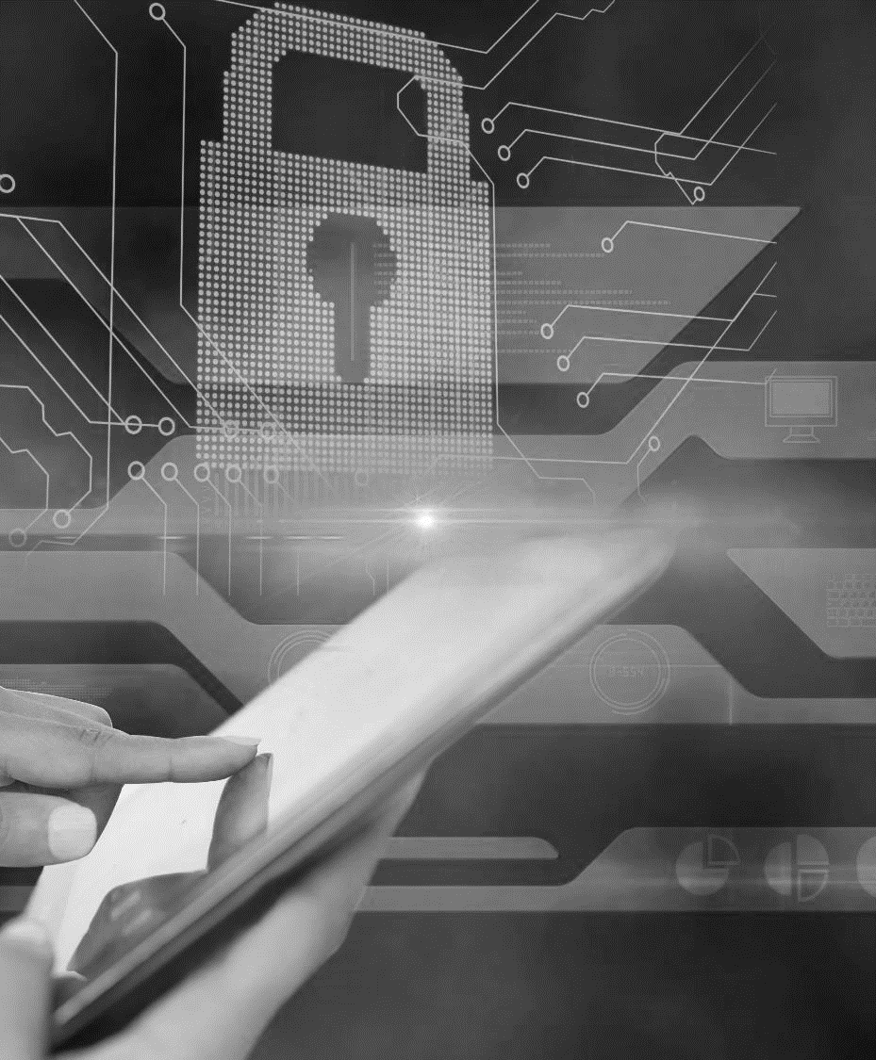
Now a days as the security breaches are increasing day by day We need to improve our security mechanism and adopt to latest mechanism for more data security and privacy.
In this system we use palm vein detection for human identification. This technique is much more preferred over fingerprint recognition due to its greater level of security and convenience.
Palm vein is chosen instead of finger vein because in the case of a finger vein, the surface area we are dealing with is much smaller than the palm, which makes it more complex.
INTRODUCTION
Notes:
https://www.freepik.com/free-photo/hand-touching-tablet_926560.htm#page=1&query=DIGITAL%20LOCK&position=0

Slide 5
EXISTING SYSTEM
In this paper they developed a novel high-performance and noncontact palm vein recognition system by using high-performance adaptive background filtering to obtain palm vein images of the region of interest.
Then they used a modified convolutional neural network to determine the best recognition model through training and testing.
Finally, the developed system was implemented on the low-level embedded Raspberry Pi platform with cloud computing technology.
The results showed that the system can achieve an accuracy of 96.54%.

Slide 6
DRAWBACKS
#1
The existing system is more expensive as it uses a raspberry pi operating system with a cloud computing platform.
#2
It has low accuracy when compared to the proposed system.
#3
It is time consuming.
#4
It is more complex process.

Slide 7
PROPOSED SYSTEM
#1
In the proposed system, we created a palm vein identification system of authorized users using deep learning.
#2
This technique is much more preferred over fingerprint recognition due to its greater level of security and convenience.
#3
Infrared (IR) light is used to illuminate the vein patterns.
#4
In the proposed system we are using VGG-19 model which is an advanced CNN with pre-trained layers and a great understanding of what defines an image in terms of shape, colour and structure.
Notes:
https://www.flaticon.com/free-icon/spam_927958?term=EMAIL%20SPAM&page=1&position=46

Slide 8
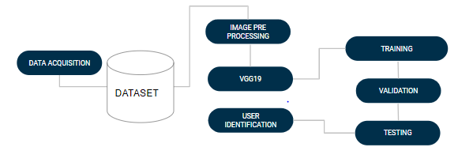
SYSTEM ARCHITECTURE

Slide 9
MODULES
#1
Data Acquisition
#2
Data Pre-processing
#3
Model Training & Testing
#4
User Identification
Notes:
https://www.flaticon.com/free-icon/spam_927958?term=EMAIL%20SPAM&page=1&position=46

Slide 10
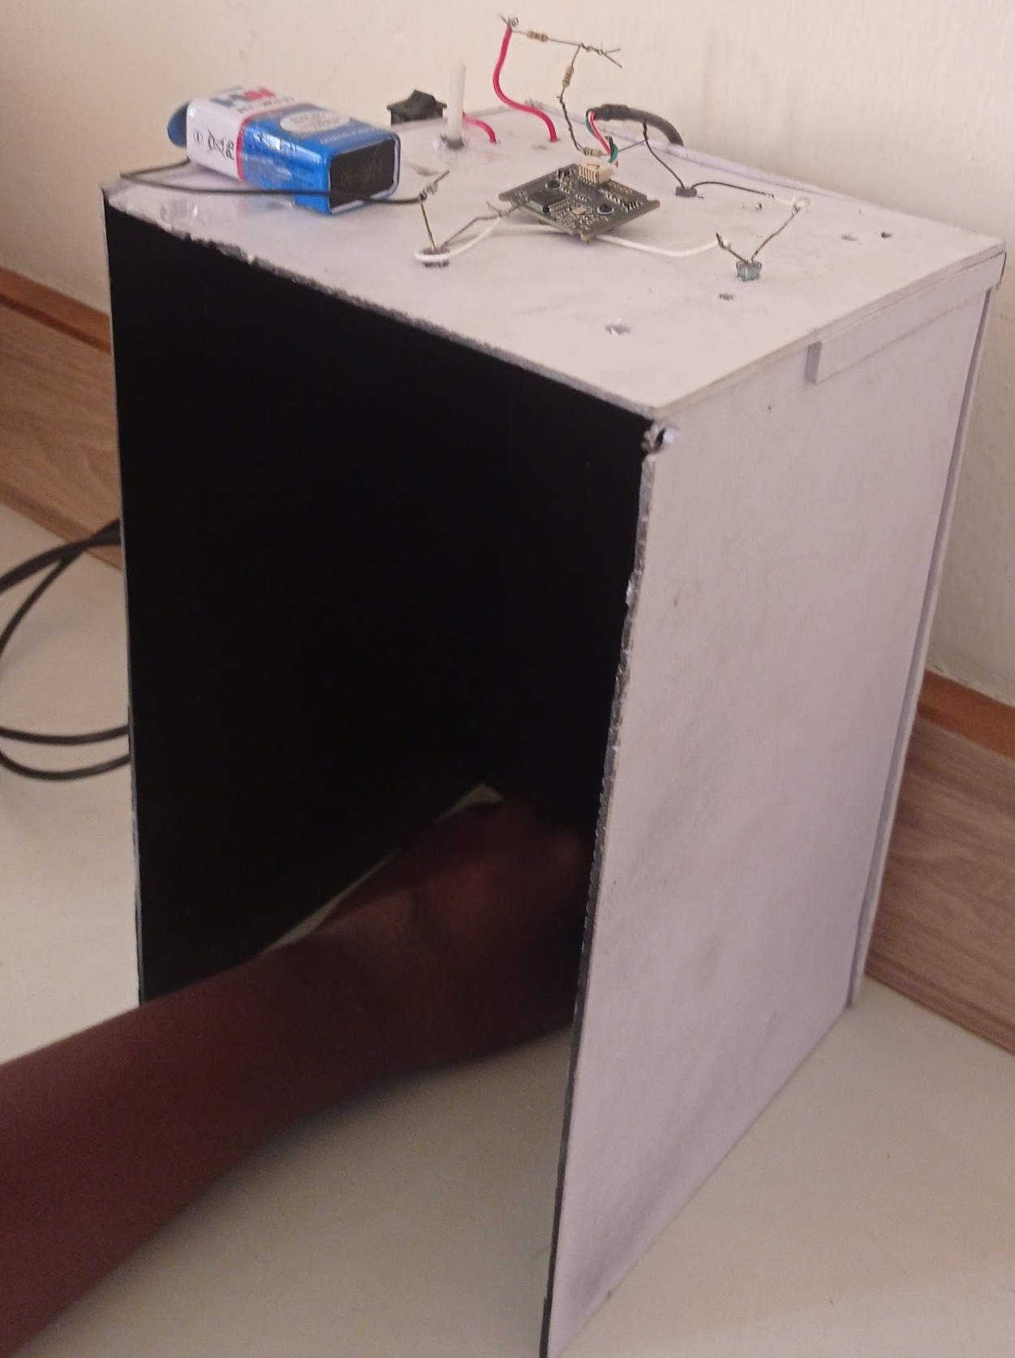
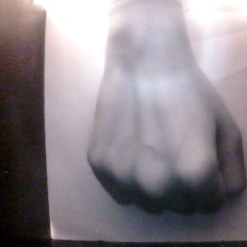
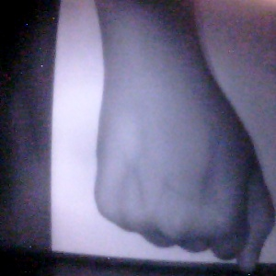
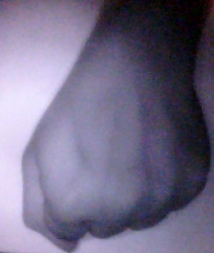
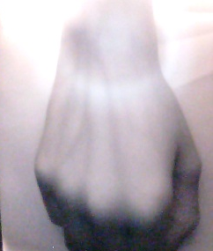
MODULE 1:
DATA ACQUISITION
CAPTURING TOOL
In this module we capture the images of users
This device is created using black foam board sheet-1m x 1m sq, LED 850nm wavelength, webcam without IR filter,battery and a switch.These are connected in a circuit for the image capturing. we collect the palm print of the users by running a python code
These images are then used to create the dataset which is stored in separate folders in a google drive.
&
SAMPLE IMAGES
Notes:
https://www.freepik.com/free-psd/laptop-mock-up-isolated_4075244.htm#page=1&query=MACBOOK%20MOCKUP&position=3
https://www.freepik.com/free-photo/female-scientist-white_4103194.htm#page=1&query=cyber%20security&position=1

Slide 11
MODULE 2:
DATA PRE-PROCESSING
&
The next process is data preprocessing where we are resizing the images and normalisation is performed.
When using the image as it is and passing through a Deep Neural Network, the computation of high numeric values may become more complex.
To reduce this we can normalise the values to range from 0 to 1. In this way, the numbers will be small and the computation becomes easier and faster. The plotting of images of authorised users are also performed.
Notes:
https://www.freepik.com/free-psd/laptop-mock-up-isolated_4075244.htm#page=1&query=MACBOOK%20MOCKUP&position=3
https://www.freepik.com/free-photo/female-scientist-white_4103194.htm#page=1&query=cyber%20security&position=1

Slide 12
MODULE 3:
MODEL TRAINING & TESTING
&
Here we are downloading the dataset to vgg19 which is a pre-trained model.
We are giving 80% images for training and 20% images for testing.Here 6 epochs are performed where each epoch trains the data then does self testing and validates the result. As the number of epoch increases the validation accuracy also improves.
A confusion matrix and learning curve is also plotted as a result of model training.

Slide 13
MODULE 4:
USER IDENTIFICATION
&
This is the final step in which we give the link of a palm vein image and check whether it is an authorised user or not.
If it is of an authorised user the name of the user is shown and if it is of an unauthorised person then it will be displayed as unknown user.

Slide 14

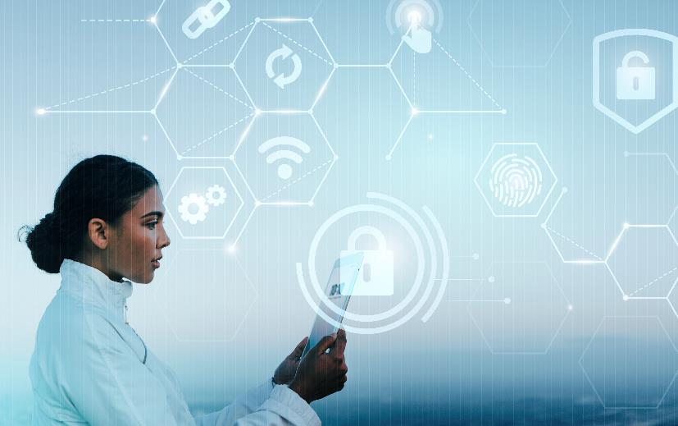
CONCLUSION
Biometric is one type of physical characteristics that can be used for person identification as it has uniqueness. Palm vein is one of the individual biometrics that has attracted researcher attention recently.
In this project we developed a system for biometric identification of authorised users. With this palm identification biometric security system we can improve the security compared to other systems such as fingerprint,iris recognition etc. The proposed methodology uses the VGG19 model to identify the user. This system has an accuracy of 98%.In future, we hope to improve this model by using different algorithms and by implementing it in a door locking system.
&
Notes:
https://www.freepik.com/free-psd/laptop-mock-up-isolated_4075244.htm#page=1&query=MACBOOK%20MOCKUP&position=3
https://www.freepik.com/free-photo/female-scientist-white_4103194.htm#page=1&query=cyber%20security&position=1

Slide 15
REFERENCES
[1]Comparative Study of Deep Learning based Finger Vein Biometric Authentication Systems,Fariha Elahee, Farhana Mim, Faizah Binte Naquib, Sharika Tabassom, Tonmoy Hossain,Kazi A Kalpoma,Department of Computer Science and Engineering,Ahsanullah University of Science and Technology (AUST),Dhaka, Bangladesh
[2]An Automated Biometric Identification System Using CNN-Based Palm Vein Recognition,Sin-Ye Jhong, Po-Yen Tseng, Natnuntnita Siriphockpirom, Chih-Hsien Hsia,Ming-Shih Huang,Kai-Lung Hua, and Yung-Yao Chen*
[3]BIOMETRIC AUTHENTICATION USING PALM DORSAL VEIN PATTERNS,Yutthana Pititeeraphab,Chuchart Pintavirooj,Department of BiomedicA Engineering,Faculty of Engineering King Mongkut's Institute of Technology,Ladkrabang (KMITL),Thailand
[4]Enhancing bank security system using Face Recognition, Iris Scanner and Palm VeinTechnology,Raj Gusain,Hemant Jain,Shivendra Pratap,Department of Electronics and Communication,Tula’s Institute, Dehradun, India
[5]Towards Building a Better Biometric System Based on Vein Patterns in Human Beings,Bini A.A.,Savio Jose,Department of Computer Science and Engineering,Indian Institute ofInformation Technology,Kottayam, India
[7]D. Zabala-Blanco, R. Hernández-García, R. J. Barrientos and R. Ahumada-García, "PVEIN-MLELM: a Novel Palm Vein Identification Approach through Multilayer Extreme Learning Machine," 2022 IEEE International Conference on Automation/XXV Congress of the Chilean Association of Automatic Control (ICA-ACCA), Curicó, Chile, 2022, pp. 1-6, doi:10.1109/ICA-ACCA56767.2022.10006171.
[8]Ö. F. Özdemir, S. Çolak and Y. S. Akgül, "Regression based stereo Palm Vein extraction and Identification system," 2016 24th Signal Processing and Communication Application Conference(SIU), Zonguldak, Turkey, 2016, pp. 1529-1532, doi: 10.1109/SIU.2016.7496043.
[9]Sanchit, M. Ramalho, P. L. Correia and L. D. Soares, "Biometric identification through palm and dorsal hand vein patterns," 2011 IEEE EUROCON - International Conference on Computer as a Tool, Lisbon, Portugal, 2011, pp. 1-4, doi: 10.1109/EUROCON.2011.5929297.
[10]D. Y. Perwira, B. W. T. Agung and M. D. Sulistiyo, "Personal palm vein identification using principal component analysis and probabilistic neural network," 2014 International Conferenceon Information Technology Systems and Innovation (ICITSI), Bandung, Indonesia, 2014, pp.99-104, doi: 10.1109/ICITSI.2014.7048245.

Slide 16
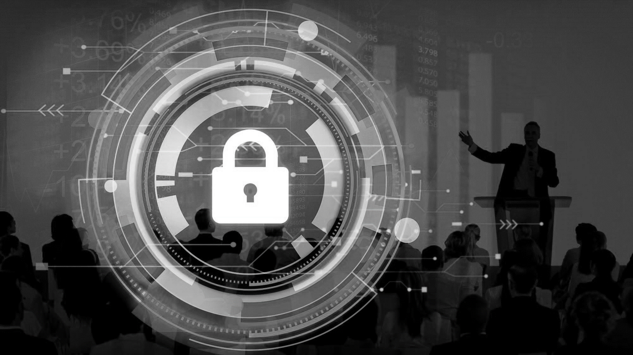
THANK YOU
Notes:
https://www.freepik.com/free-photo/business-corporate-protection-safety-security-concept_3533269.htm#page=1&query=cyber%20security&position=0

